Slide 1
Group Meeting Huang Group
22-2-23
Melania

Slide 2
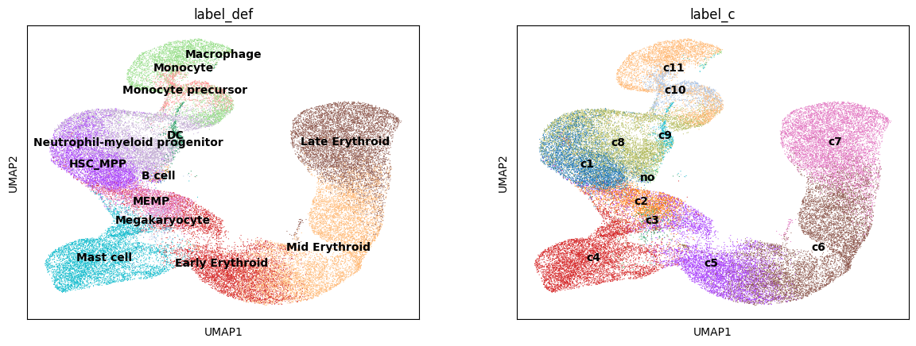
Problem
We want to build a model for clonal dynamics for in vitro time course data in human/murine haematopoiesis
3 time points
Persistent clones

Slide 3
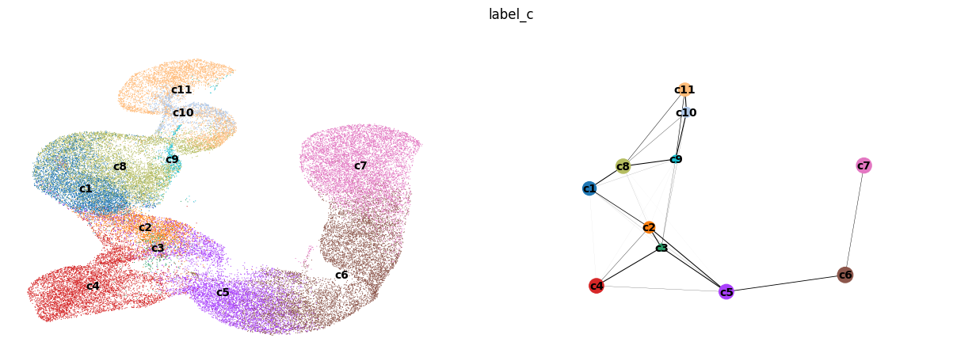
Using the transcriptome: clusters and graph

Slide 4
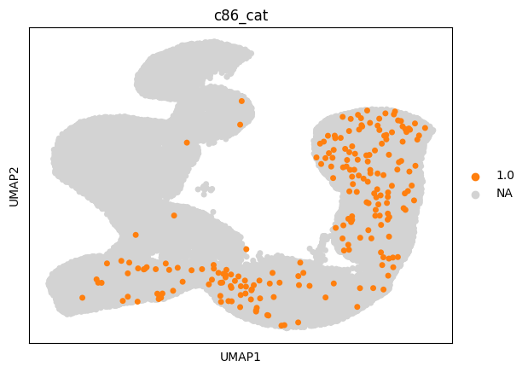
One clone (out of >4000)

Slide 5
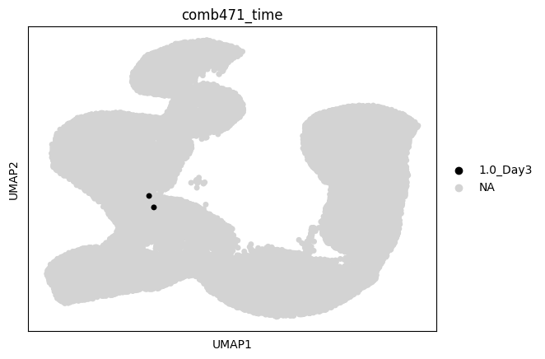
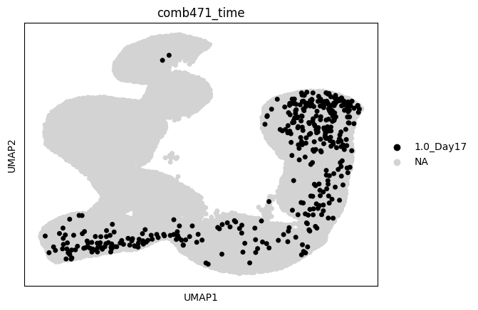
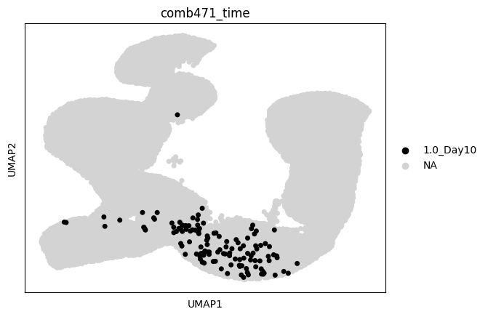
One clone: time course

Slide 6
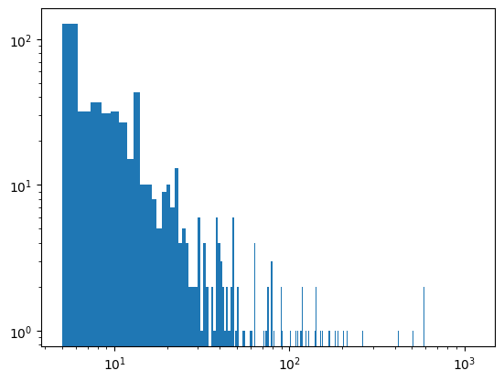
Small number of barcoded cells per clone
Build a count matrix (4000 x 33)
Each row is a clone
Each column (feature) is the number of cells in a population at a certain time
Then:
Cluster on the umap
Or hierarchical clustering
Number of cells per clone
Note: number of cells is scaled to experimental total number of cells→ greater uncertainty

Slide 7
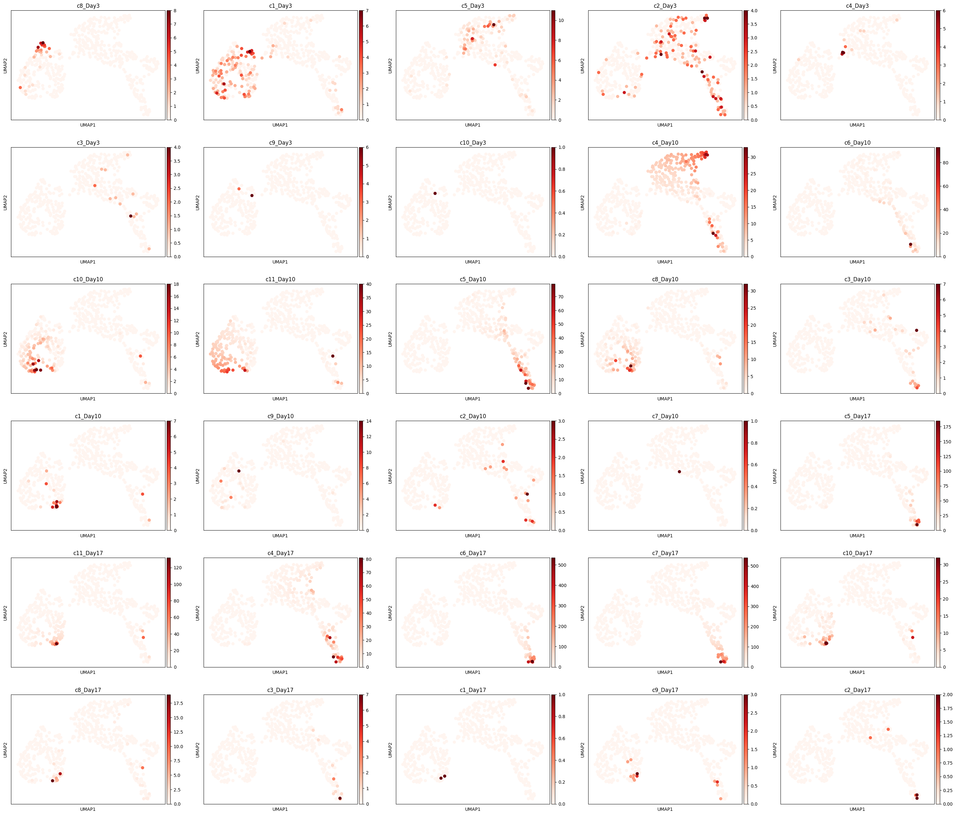
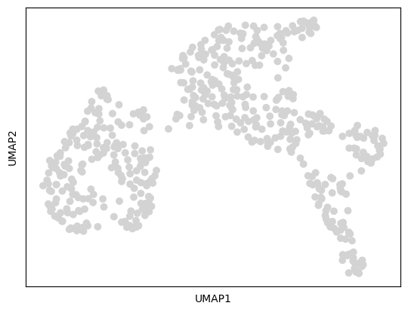
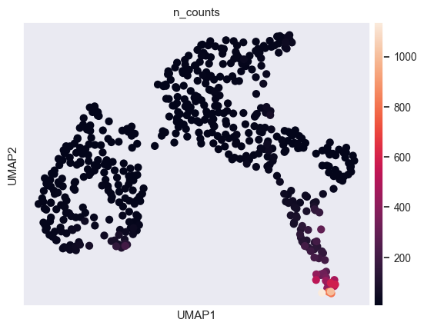
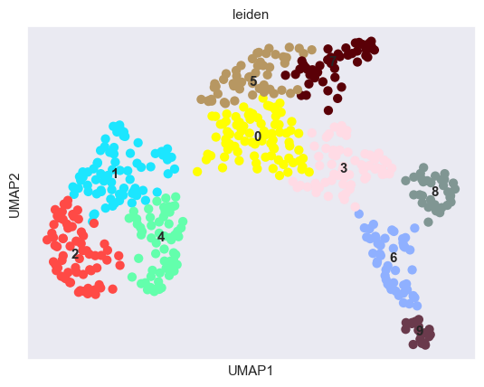
Clustering

Slide 8
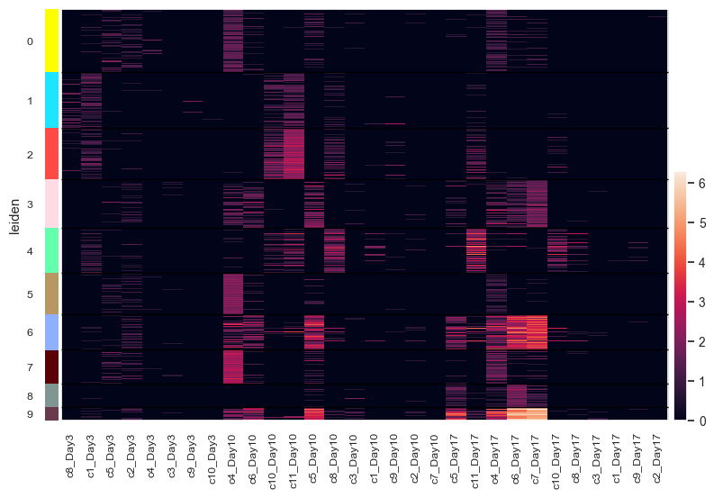
Clustering

Slide 9
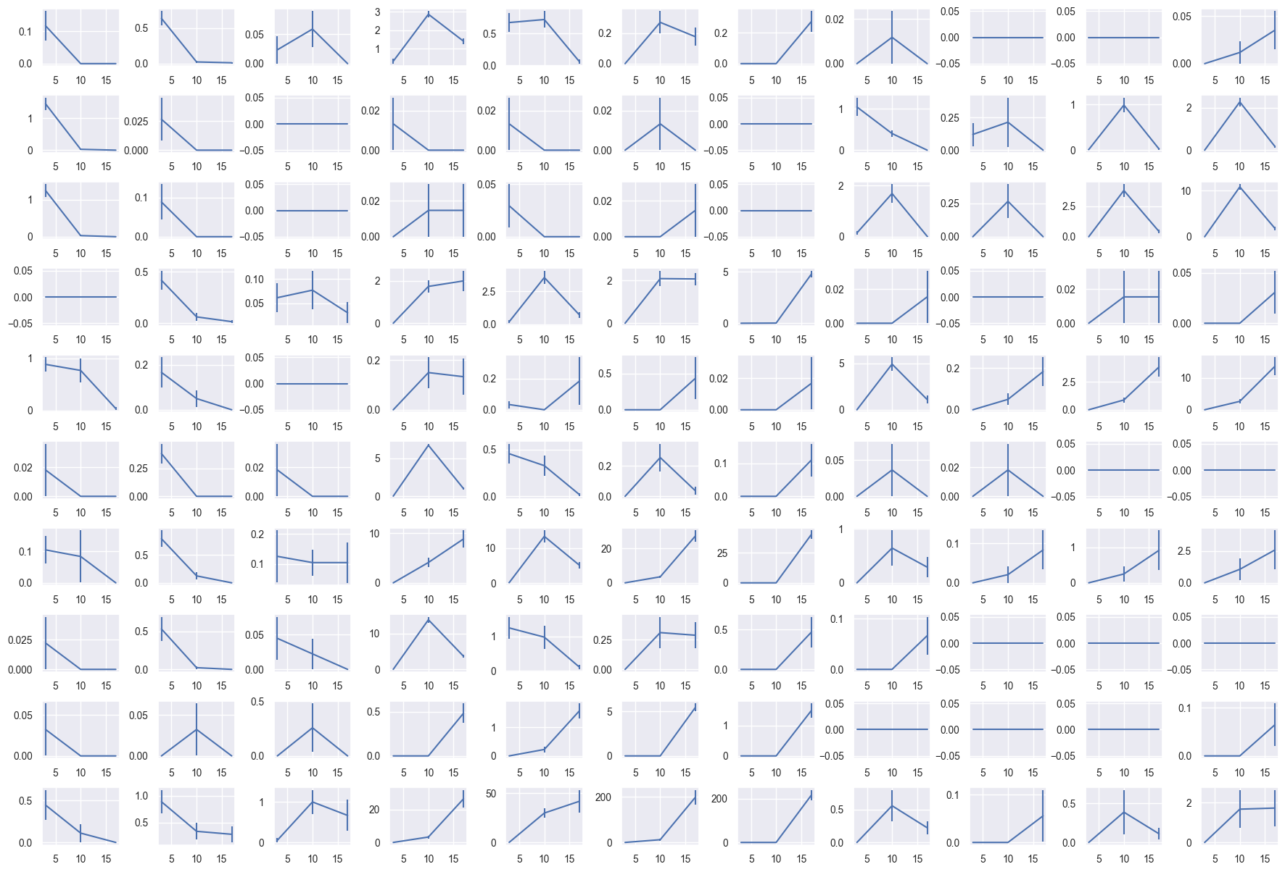
Data for model
Populations 1-11
Good way to estimate variance?
Mean or sum?
Average cell number
Time (d)

Slide 10
Model principles
Arrow direction given by dpt
Backward? Cell cycle?
Note: time-independent parameters!

Slide 11
Reducing dimensionality
Average behavior (barcoded + non barcoded)

Slide 12
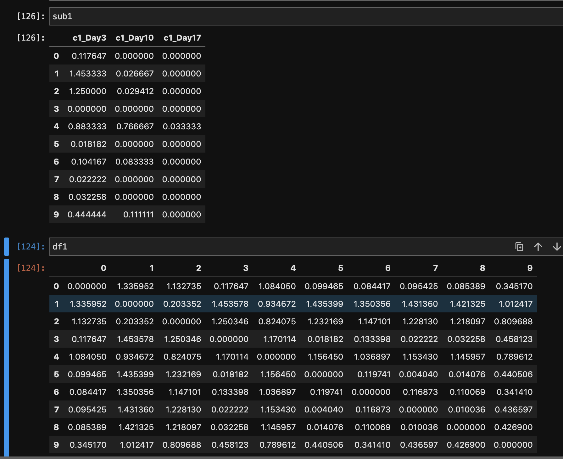
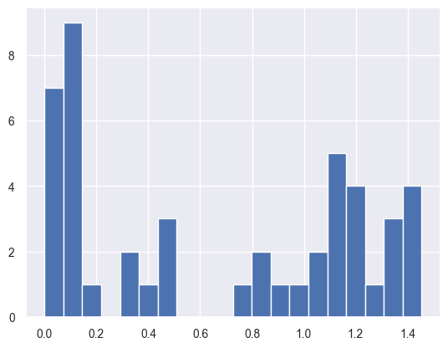
Reducing dimensionality

Slide 13
Solving the cost function

